Slide 1
Class 1
The State of Play in International Trade and Trade Policy I:
Trade Wars by
Alan V. Deardorff
University of Michigan
2020
PubPol/Econ 541

Slide 2
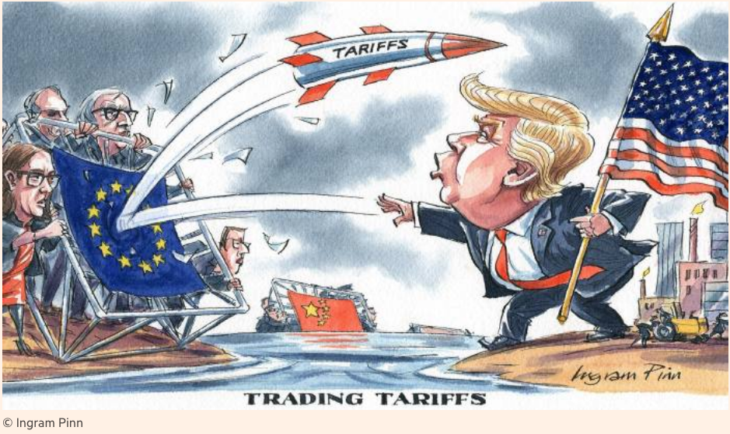
Notes:
Pinn, Ingram, “Ingram Pinn’s illustration of the week: Trading tariffs,” Financial Times, June 22, 2018.
https://www.ft.com/content/c56ebb64-7579-11e8-b326-75a27d27ea5f

Slide 3
Trade Wars, 2018-2020
Outline
  Battles in the Trade Wars
    Washing Machines & Solar Panels
    Steel & Aluminum
    Intellectual Property
    US-China Trade War
    Cars
    Mexico migration
    Digital Tax
    Targeting Companies
  Effects of the Trade Wars

Slide 4
  Washing Machines
  & Solar Panels
Safeguards Protection
  Section 201 of US trade law
  Tariffs when surge of imports causes injury
  Legal in WTO
US action
  USITC recommended Oct 31, 2017
  Trump levied tariffs January 2018
  Korea and China filed complaints at WTO

Slide 5
  Steel & Aluminum
National Security
  Section 232 of US trade law
  Tariffs on imports that “threaten national security”
  “National security” is not defined
  Legality in WTO is unclear
Feb 16, 2018: Commerce finds security threat

Slide 6
  Steel & Aluminum
National Security
  Mar 1: Trump levies tariffs
    25% on steel
    10% on aluminum
    Against all countries
      Several removed shortly thereafter
      Remained in place on EU, China, Canada, Mexico, and others
    Retaliation by all
    (Tariffs on Canada & Mexico later removed, then reinstated on Canadian aluminum Aug 6, 2020)

Slide 7
Pause for Discussion

Slide 8
  Questions
The US constitution reserves to Congress the right to levy tariffs. Why, then, was Trump able to do it?
Trump’s right to levy tariffs on steel was challenged. On what basis?
Is there any likelihood that Section 232 will be changed by Congress to make such actions less likely?

Slide 9
  Intellectual Property
Intellectual property
  Usually includes patents, trademarks, copyrights, and trade secrets
  US (and others) claim that China
    Steals technology secrets
    Forces investors to turn over technologies in joint ventures

Slide 10
  Intellectual Property
USTR (United States Trade Representative, Robert Lighthizer)
  Initiated investigation of China’s IP practices
  Under Section 301 of US trade law – Unfair trade practices
  This is not something permitted by the WTO

Slide 11
  US-China Trade War
March 22, 2018: Report finds unfair trade practices
  IP violations (see above)
  Also subsidies to firms and state-owned enterprises (SOEs) to trade unfairly
Trump announces tariffs on up to $60 billion of China’s exports to US

Slide 12
  US-China Trade War
US and China levy tariffs on each other
  Three times in 2018, twice in 2019
    Trump either added new tariffs on China exports or raised them
    Each time, China responded with tariff on US exports
  Threat of more in December 2019 was suspended by “Phase One” US-China Trade Deal

Slide 13
Williams and Hammond,
Table 3: Section 301 tariffs on China
Stage | Date | Tariff | Tariff lines | Imports ($ bil)
1 | 7/6/18 | 25% | 818 | 34
2 | 8/23/18 | 25% | 279 | 16
3 | 9/24/18 | 10% | 5,733 | 200
3 | 5/10/19 | Raise to 25%
4A | 9/1/19 | 15% | 3,229 | 126
4B | 12/15/19 (suspended) | 15% | 542 | 156
4A | 2/14/20 | Lower to 7.5%
Notes:
Williams, Brock R. and Keigh E. Hammond, “Escalating U.S. Tariffs: Timeline,” Insight, Congressional Research Service, updated January 29, 2020

Slide 14
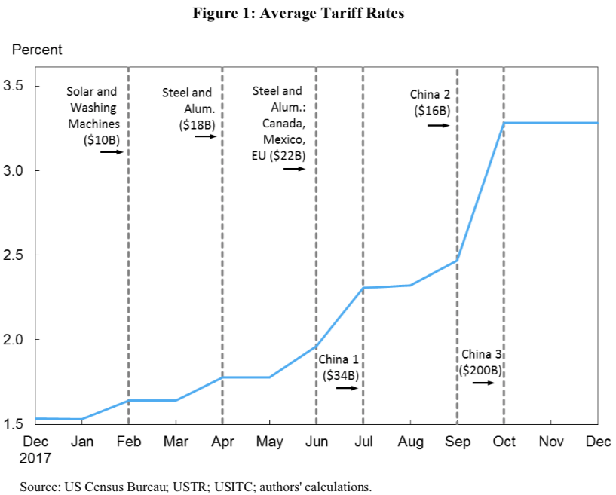
Source: Amiti, et al. 2019.

Slide 15
  US-China Trade War
Phase One Deal
  In anticipation, Trump called off December 2019 tariffs
  Agreement signed January 15, 2020
Content of Deal:
  China to buy $200 billion more US exports
  US to reduce a few tariffs on China
  Most tariffs by both remain in place, and China did not address subsidies and SOEs

Slide 16
  US-China Trade War
Phase One Deal as of today
    (Swanson and Bradsher)
  Pandemic hit trade hard and slowed China’s imports
  Otherwise, both sides seem happy with the progress
  Trump: “We’re doing very well on our trade deal but I feel differently about China than I’ve ever felt.”
  He has other complaints, as we’ll see

Slide 17
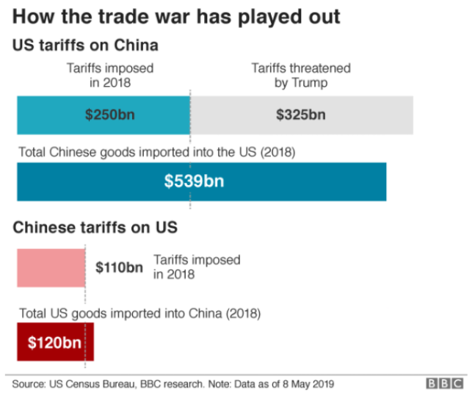
Notes:
Palumbo, Daniele and Ana Nicolaci da Costa, “Trade war: US-China trade battle in charts,” BBC News, May 10, 2019.

Slide 18
  Threats
Tariff on Cars
  Based on national security
  Still pending
Tariff on all goods from Mexico
  Based on immigration
  Planned, then cancelled

Slide 19
Pause for Discussion

Slide 20
  Questions
To what extent did China always retaliate at the same level as the US had hit them?
Who are mentioned in the headlines as benefiting from the trade war?
Is China on track to increase imports by the amount promised?
Is China doing anything to improve its behavior on intellectual property?

Slide 21
  Digital Tax
The Issue:
  The international norms for taxing firms are based on firms’ physical locations
  As a result, firms that operate over the internet avoid taxation in countries where they lack physical presence
  This issue has been of concern for years, but discussions of fixing it have not succeeded
  The US resists any change, since it is almost entirely US companies that benefit

Slide 22
  Digital Tax
Negotiations
  Discussions have been underway in the OECD to devise a new global tax framework
  France in 2019 enacted a Digital Services Tax (DST), not waiting for a new framework
  The US threatened retaliation, and in January, both paused, awaiting results from the OECD
  But in June, the US pulled out of the OECD talks, saying they had reached an “impasse”

Slide 23
  Digital Tax
France now says its DST will go into effect at the end of 2020
  The DST is a 3% tax on revenues earned by providing goods or services to French users over the internet.
  While it applies to companies from all countries, the most affected will be from the US: Facebook, Google, and Amazon

Slide 24
  Digital Tax
Trump’s response
  On July 10 he announced new 25% tariffs on $1.3 billion of French goods
    They will be delayed until January 2021
Now other countries are considering a tax like that of France.
  Italy, Spain, Austria, UK

Slide 25
  Targeting Chinese Companies
Trump has used national security as the grounds for a series of actions against Chinese companies
  ZTE
  Huawei
  TikTok

Slide 26
  Targeting Chinese Companies
ZTE
  In 2018 Trump banned US firms from selling products to ZTE,
    a major Chinese maker of telecoms equipment,
    concerned that it would let Beijing spy on the US
  After several months and reversals of the policy, ZTE was allowed to continue.
    Trump used it as bargaining chip with President Xi
    ZTE “loaded up on lobbyists”
Notes:
Swanson & Vogel, “Faced With Crippling Sanctions, ZTE Loaded Up on Lobbyists,” New Hork Times, Aug 1, 2018.
https://www.nytimes.com/2018/08/01/us/politics/zte-sanctions-lobbying.html?rref=collection%2Fissuecollection%2Ftodays-new-york-times&action=click&contentCollection=todayspaper&region=rank&module=package&version=highlights&contentPlacement=5&pgtype=collection

Slide 27
  Targeting Chinese Companies
Huawei
  The world’s leading maker of 5G telecoms equipment, among many other things
  US worried that, though a private company, the Chinese government could use it to spy
  2012: US firms were encouraged not to buy from Huawei
  2018: US asked allies not to buy from Huawei, but few complied (New Zealand, UK)
Notes:
Swanson & Vogel, “Faced With Crippling Sanctions, ZTE Loaded Up on Lobbyists,” New Hork Times, Aug 1, 2018.
https://www.nytimes.com/2018/08/01/us/politics/zte-sanctions-lobbying.html?rref=collection%2Fissuecollection%2Ftodays-new-york-times&action=click&contentCollection=todayspaper&region=rank&module=package&version=highlights&contentPlacement=5&pgtype=collection

Slide 28
  Targeting Chinese Companies
Huawei (cont.)
  December 2018: Canada arrested Huawei CFO to extradite to US for violating US sanctions on Iran
  May 2019: US firms were banned from selling chips made in US to Huawei
  Aug 17, 2020: US “prohibits anyone from selling any chips to Huawei, custom or not, if these were produced with American technology” (Economist)

Slide 29
  Targeting Chinese Companies
TikTok
  A very popular video app owned by the Chinese company ByteDance, is said by Trump to threaten national security
    By making data on its users available to the Chinese government
  First threatening to ban it in the US, he now is encouraging its acquisition by a US company
    Candidates are Microsoft, Oracle, and Walmart

Slide 30
  Targeting Chinese Companies
WeChat
  A messaging app owned by TenCent
  Subject to concerns and similar to TikTok

Slide 31
Pause for Discussion

Slide 32
  Questions
How could China respond to the US actions against Huawei? Is it doing anything?
Do the US actions against Huawei prevent all US companies from supplying Huawei?
Do the US actions against ZTE, Huawei, and TikTok help or hurt US consumers and US companies?

Slide 33
  Effects of the Trade Wars
Sectors that are hit
On trade with China
On the US trade balance
Stock markets

Slide 34
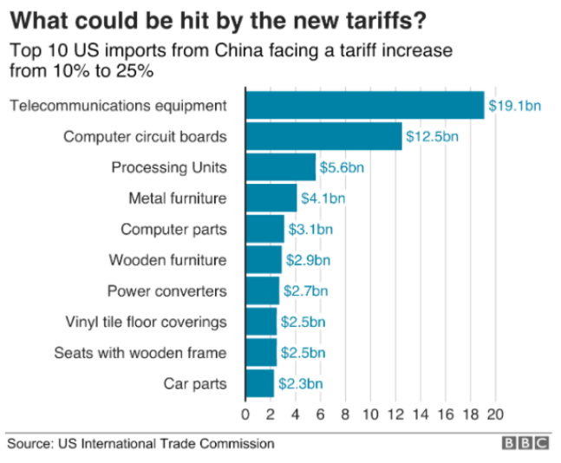
Notes:
Palumbo, Daniele and Ana Nicolaci da Costa, “Trade war: US-China trade battle in charts,” BBC News, May 10, 2019.

Slide 35
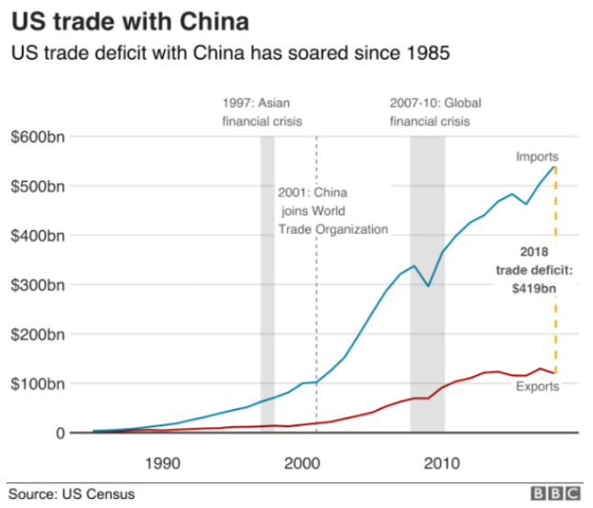
Notes:
Palumbo, Daniele and Ana Nicolaci da Costa, “Trade war: US-China trade battle in charts,” BBC News, May 10, 2019.

Slide 36
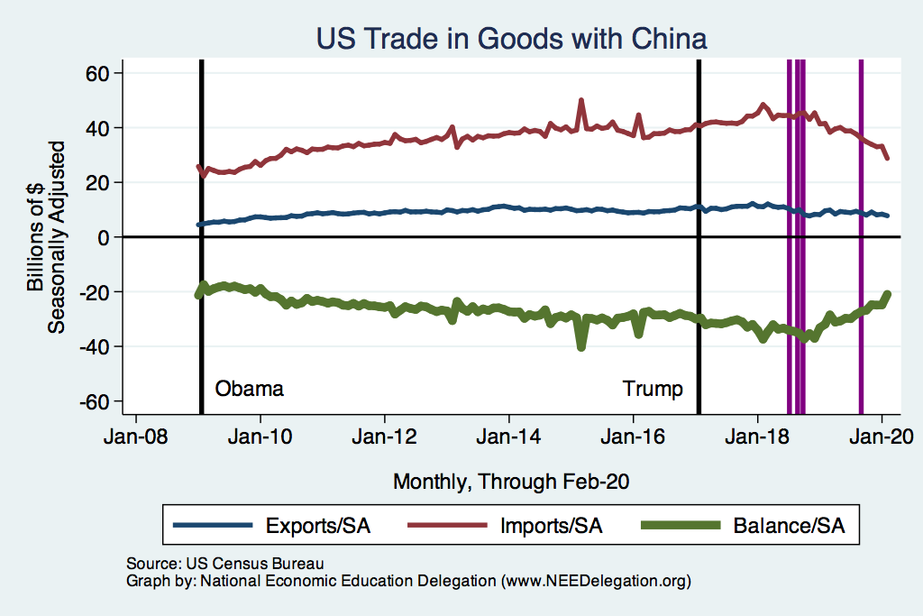
US Trade with China
Notes:
Presentations / NEED / Graphs202007

Slide 37
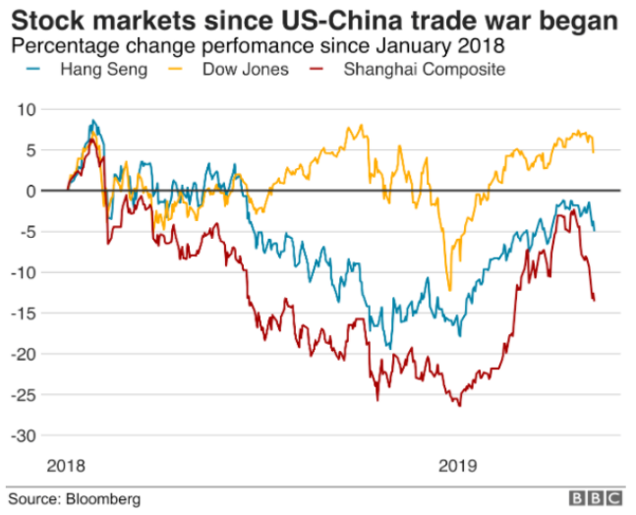
Notes:
Palumbo, Daniele and Ana Nicolaci da Costa, “Trade war: US-China trade battle in charts,” BBC News, May 10, 2019.

